Slide 1
Bell Ringer
Should tobacco be illegal? Why or why not?
Discuss with classmates around you.
Be prepared to share.

Slide 2
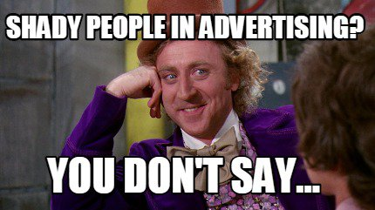
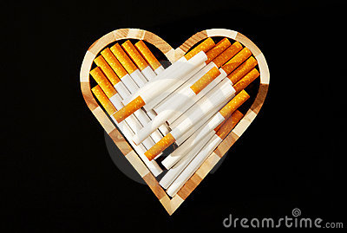
Joe
Carrie
Alyse
Jordan
Devin
Asher
Dijyot
Adam
Joselyn
Jenifer
Lizzie
Igor
Scott
Coleton
Marissa
Carissa
Miles
Zach
Harry
Gabe
Shane
Matthew
Noah
Kylie
Shireef

Slide 3
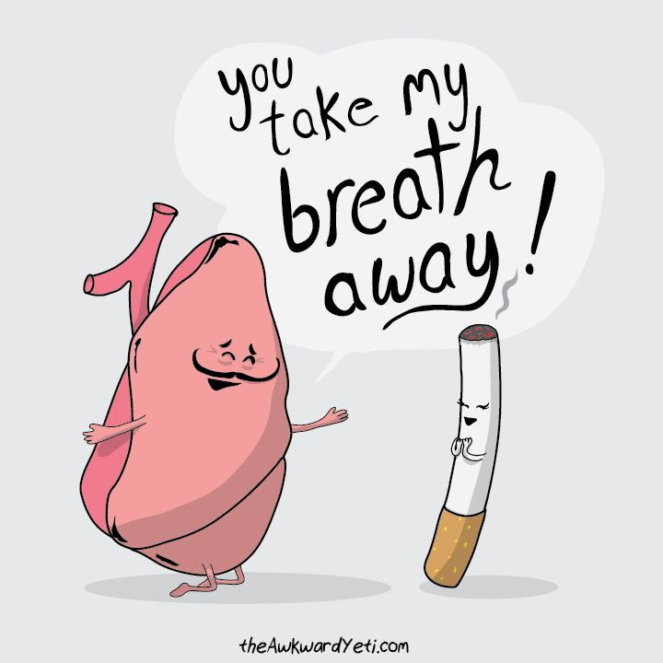
What you need:
Laptop
Pencil
Packet

Slide 4
Bell Ringer
What is the biggest impact tobacco has on your body?
Discuss with classmates around you.
Be prepared to share.

Slide 5
Tobacco Stations
6 groups (1 group per station)
10 minutes at each station
Complete and discuss stations as a group
Time at the end to go back if unfinished

Slide 6
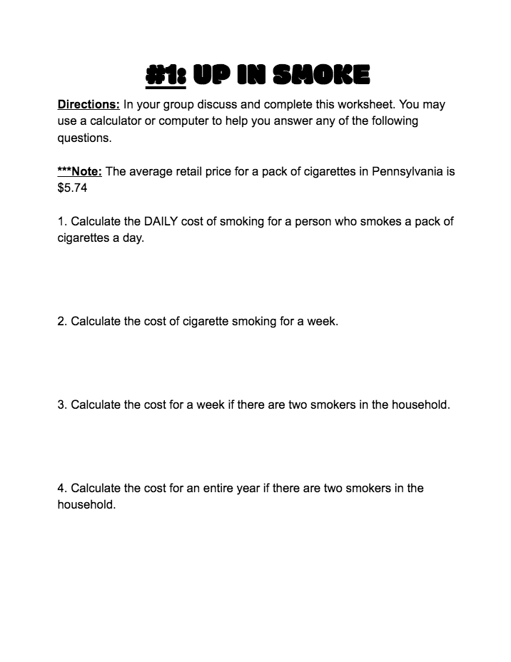
Up In Smoke
What can be purchased with the money that would be saved?

Slide 7
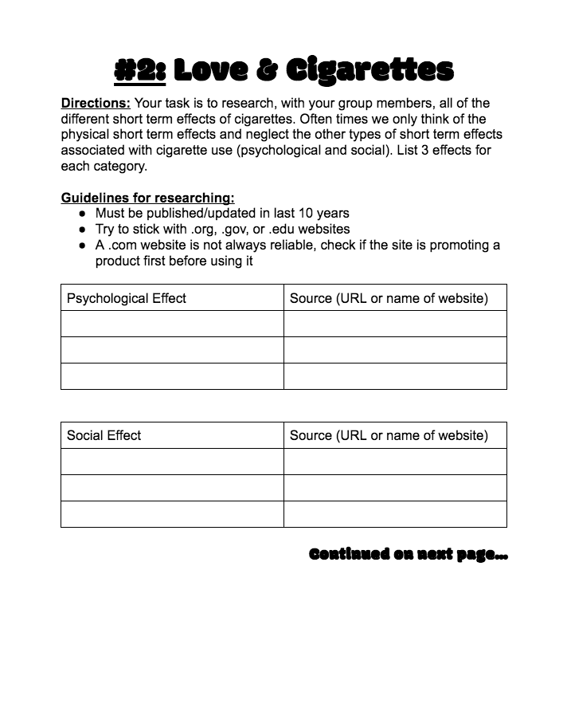
Love & Cigarettes
What are the social effects of smoking?
*CHROMEBOOK*

Slide 8
Dating a Smoker

Slide 9
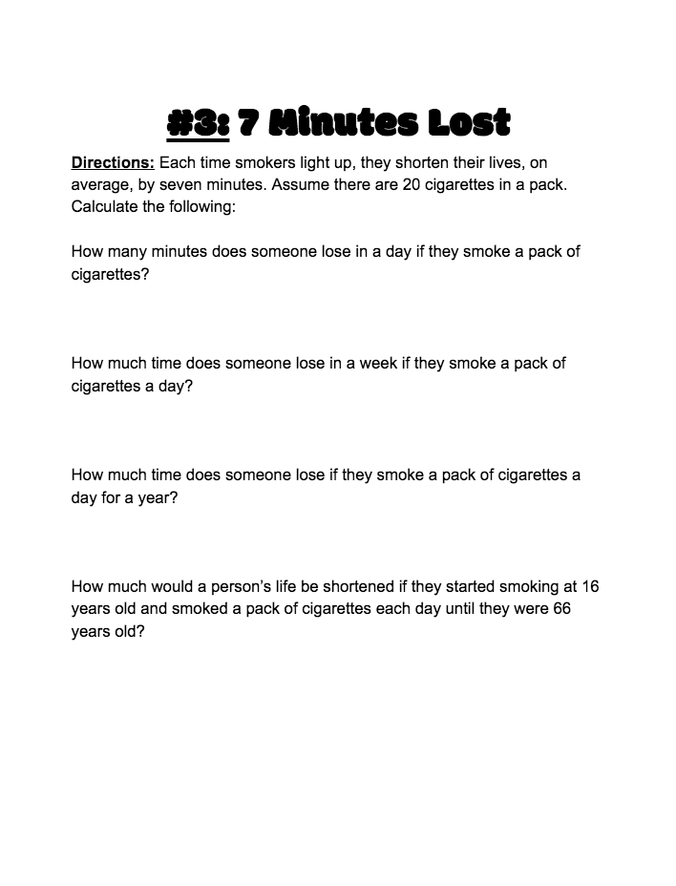
7 Minutes Lost
How much time can be lost from a lifetime of smoking?
About 4 years

Slide 10
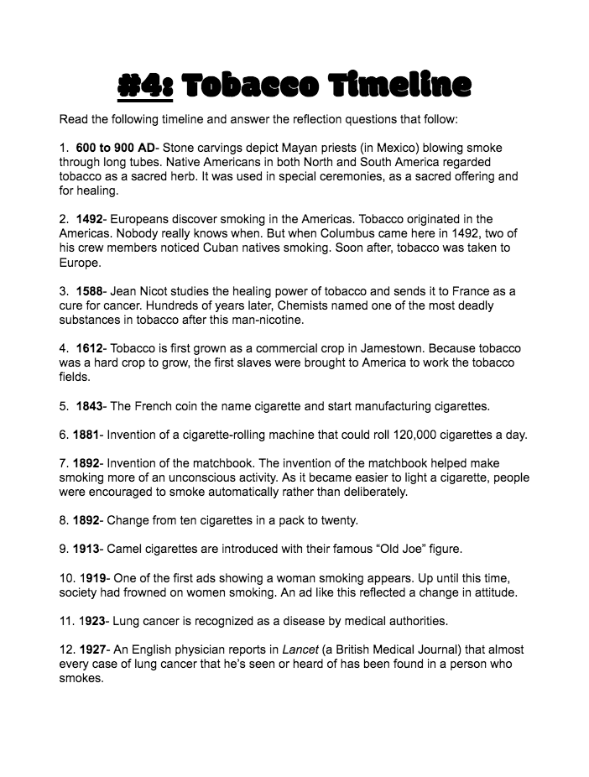
Tobacco Timeline
What was one event in history that stood out to you?

Slide 11
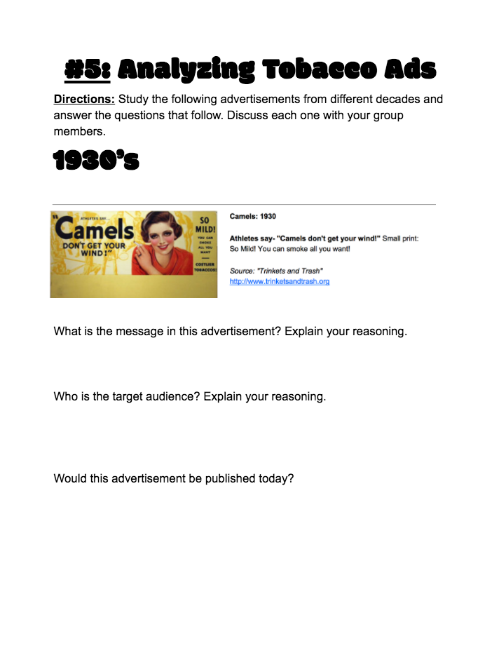
Analyzing Tobacco Ads
Who is the target audience of tobacco ads?

Slide 12
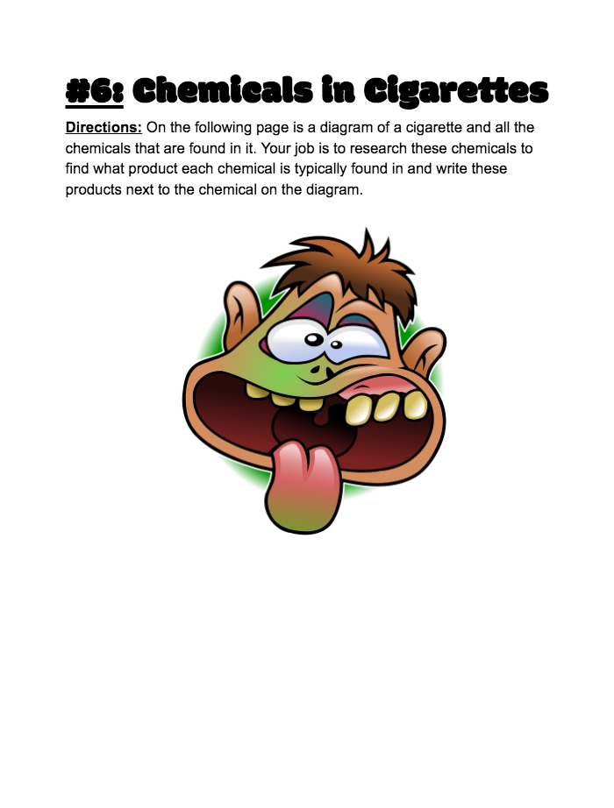
Chemicals in Cigarettes
What products are the chemicals in cigarettes also found in?
*Chromebook*

