Slide 1
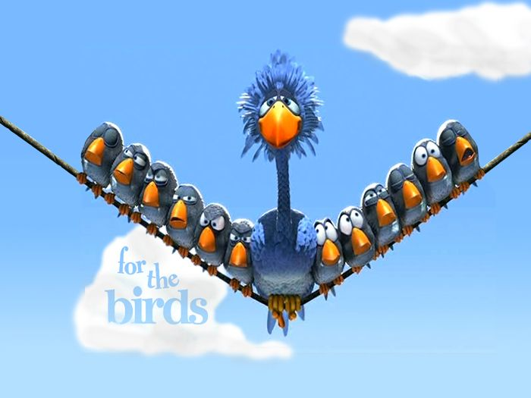

Slide 2
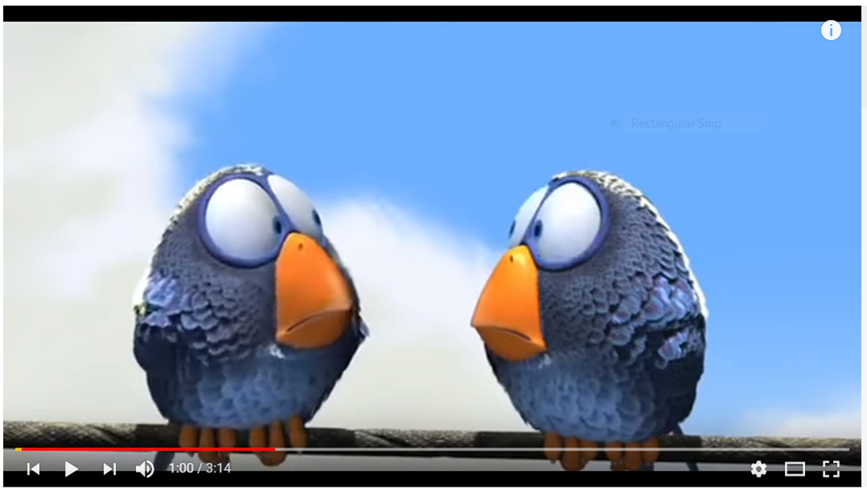
Watch and think…
“What’s the purpose of this video?”

Slide 3
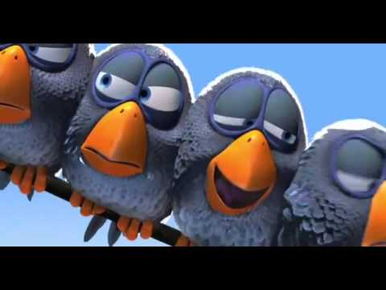

Slide 4
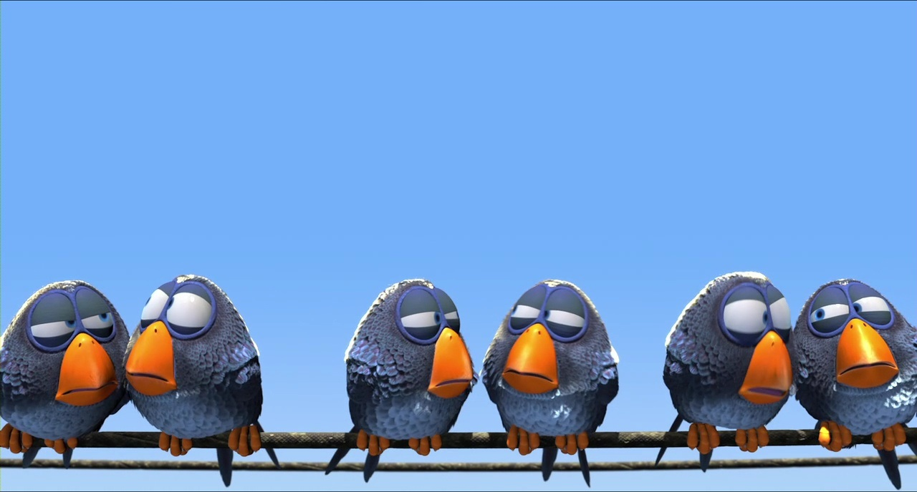
Friendship
________________ a relationship between people who enjoy being together.
What other
qualities do good
friends have?
GOOD FRIENDS ARE…
_______________ - dependable
_______________ - loyal
_______________ - share another person’s feelings
Reliable
Faithful
Empathetic

Slide 5
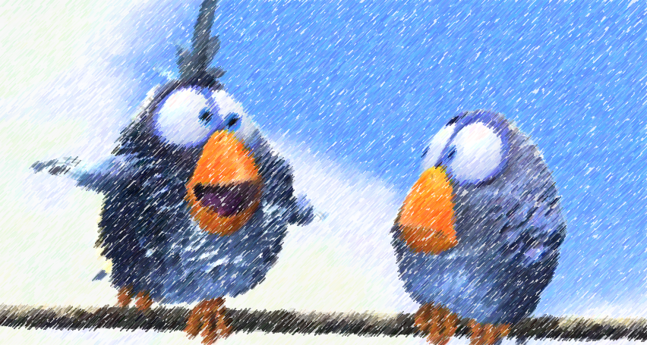
What makes a bully…a “bully”?
What about teasing or taunting?
A bully is someone who repeatedly
and purposely seeks to cause harm.

Slide 6
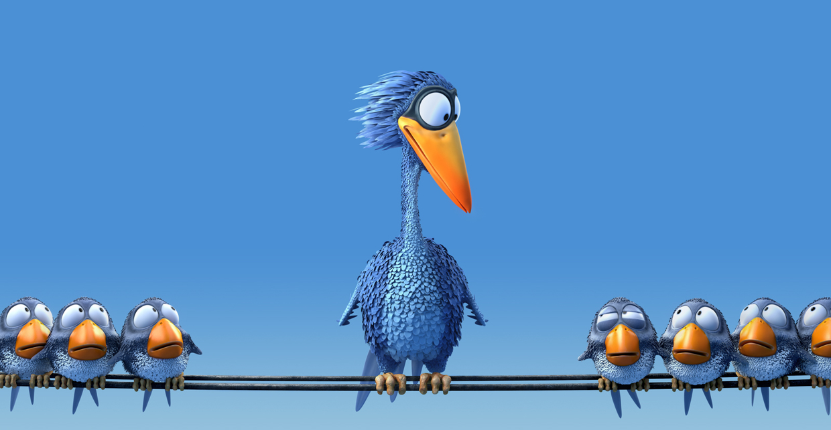
TAUNTING
1 sided, power imbalance
Intended to hurt
Humiliating
Laughing AT other
Disguised as a joke
Harms self-esteem
Continues when told to STOP
TEASING
Roles can swap
Not meant to hurt
Only 1 part of relationship
Humor in voice
Both parties laugh
No harm to self-esteem
STOPS when asked them to

Slide 7
Watch AGAIN and think…
“What’s going on here? Is this teasing?
Taunting? Or something else?”

Slide 9
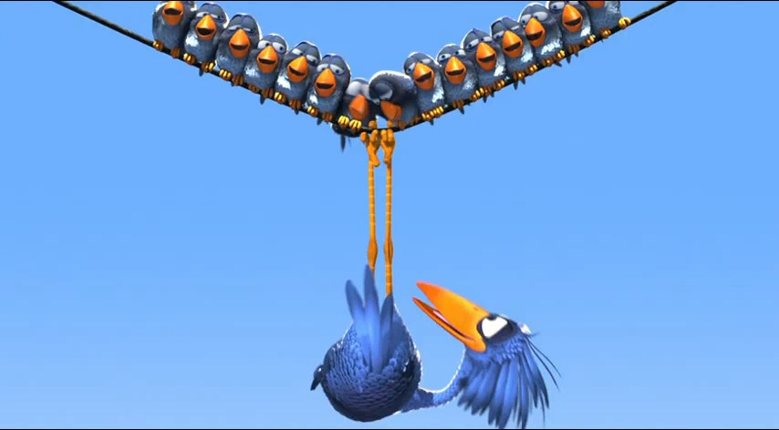
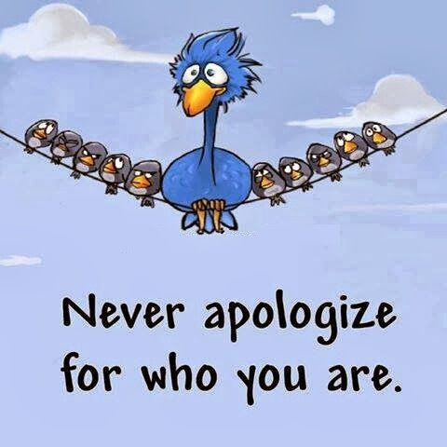
The larger blue bird did not seem bothered by the actions of the little birds…why do you think that is?

Slide 10
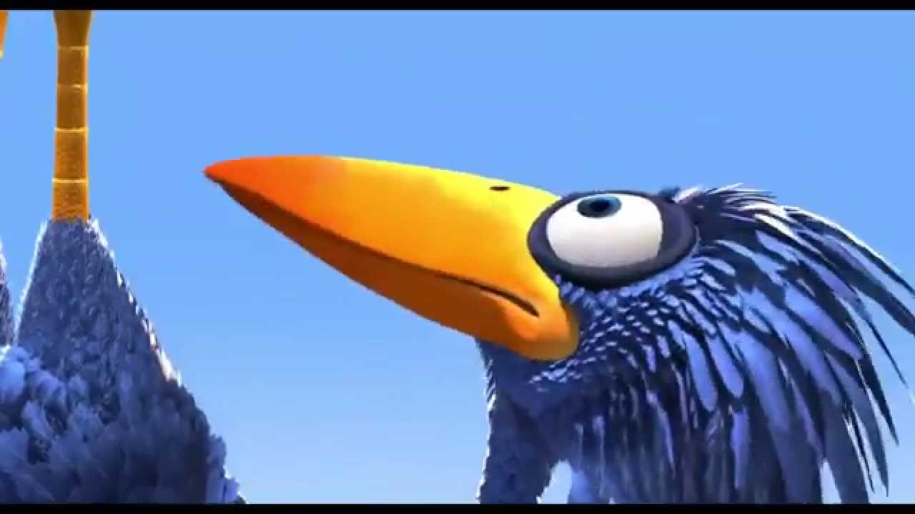
PERSPECTIVE

Slide 11
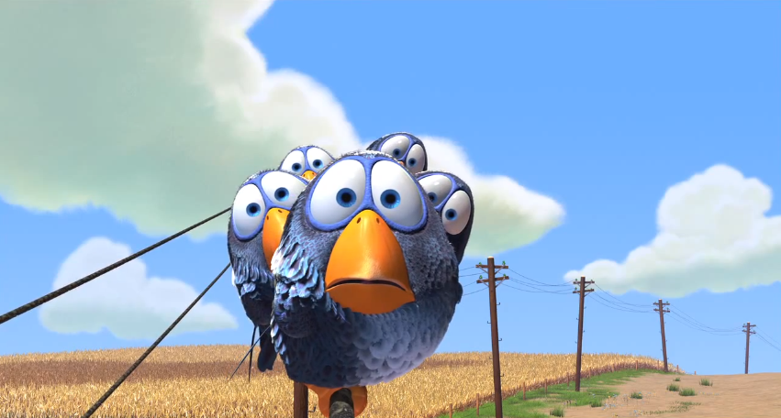
FOR THE BIRDS

