Slide 1
Stop it!
Campaign to stop bullying

Slide 2
Objectives
The student will explain how bullying and harassment affect health and safety. (7.1u)
The student will create a campaign to prevent bullying in school and online. (7.3s)

Slide 3
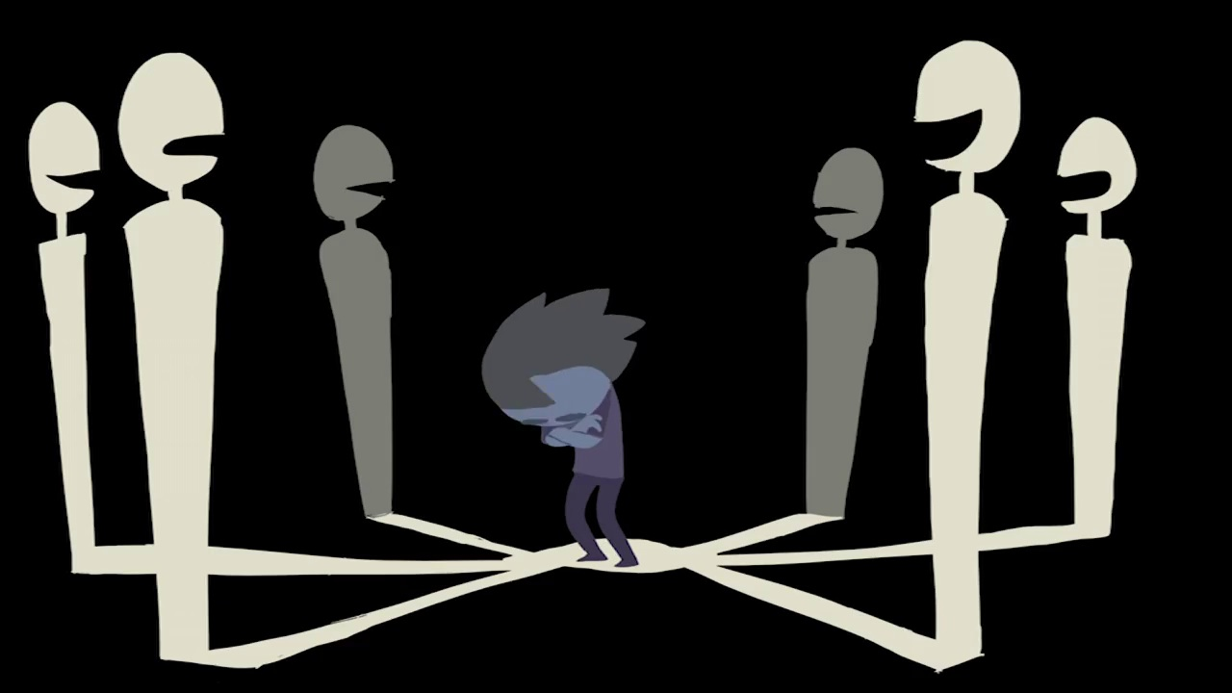
Leo and Ben
Leo and Ben were friends in elementary school but when they were in middle school something happened. Leo started spreading rumors that Ben cheats on tests, copies homework, and is mean to his friends.
Ben is very upset because everything Leo says is a lie. Leo is sending nasty emails, posting false stories on Facebook, and Tweeting out things that never happened. When Ben sees him is school, Leo ignores him but makes gross noises after he passes.
Lately, Ben can’t eat without getting a stomach ache. He is hungry by lunch but he is afraid to go into to lunch room because he doesn’t know if others believe Leo and would be mean to him.
He is having trouble concentrating in class and his grades are starting to go down. He is very stressed because he was a B+ student until all this happened. He doesn’t know what to do or who to tell.
This Photo by Unknown Author is licensed under CC BY-NC-SA

Slide 4
Leo and Ben
School work: quality decreases
Body systems: stomach ache
Going to the cafeteria: Reluctant to go to the cafeteria, afraid
Mental health: Jumpy, anxious, sad, depressed, stressed, no energy
Sleep: Trouble sleeping

Slide 5
What are the long term effects on the bully?
Not allowed to participate in sports.
Suspension
Legal problems due to violating laws

Slide 6
What to do
What not to do
Tell an adult
Try to avoid being alone
Ignore the bully and confidently walk away
Hold the anger because the bully wants you to get angry.
Use your wits! Try using humor. It may confuse the bully and you get to leave confidently.
Take charge of your life! Get involved in activities that make you feel good about yourself.
Talk about the bullying to a trusted adult or friend who can give you support.
Find your true friends and share your feelings about what is happening.
Don’t get physical.
Practice confidence
Don’t tell anyone. It will only make things worse.
Stay by yourself. Involving others will only cause them to be bullied also.
Taunt the bully back. That is what he/she understands.
Yell at the bully and show your emotion. It might scare him/her.
Don’t give smart responses to the bully, it will only anger him/her.
Stay home and try not to communicate with anyone until the bullying stops.
Don’t tell anyone about the bullying. It will only make things worse.
Don’t tell your friends. They will be afraid to hang out with you.
Fight back!
Look scared.

Slide 7
Review questions
Name one way bullying effects the body? (7.1u)
Name one effect of bullying on the bully. (7.1u)
Name one thing a teen can do if being bullied. (7.3s)

